Slide 1
Installing Anaconda, Variables and Constants, Datatypes

Slide 2
Installing Anaconda
Anaconda is an open-source software that contains Jupyter, spyder, etc that are used for large data processing, data analytics, heavy scientific computing.
Anaconda works for R and python programming language. Spyder(sub-application of Anaconda) is used for python.
Opencv for python will work in spyder. Package versions are managed by the package management system called conda.
To begin working with Anaconda, one must get it installed first. Follow the below instructions to Download and install Anaconda on your system:

Slide 3

Download and install Anaconda:
Head over to anaconda.com and install the latest version of Anaconda. Make sure to download the “Python 3.7 Version” for the appropriate architecture.

Slide 4


Slide 5
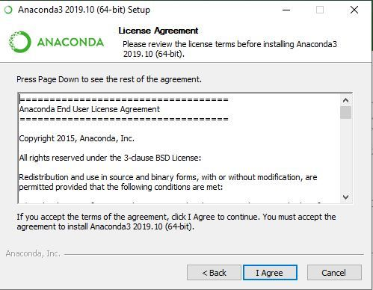

Slide 6
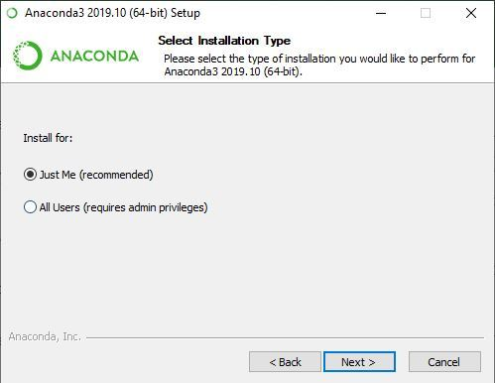

Slide 7
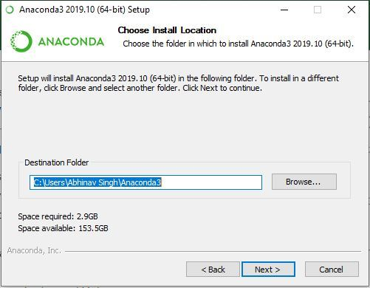

Slide 8
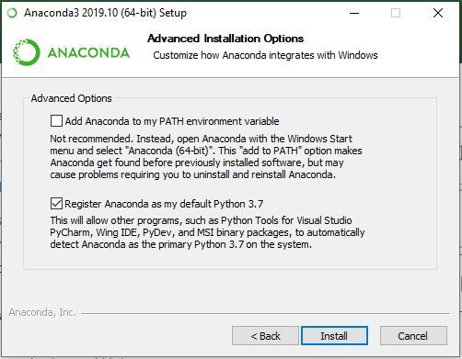

Slide 9
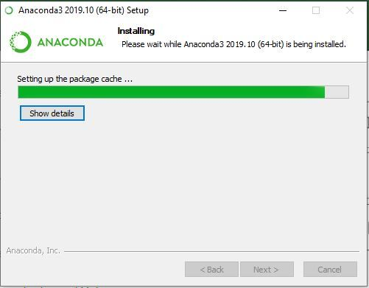

Slide 10


Slide 11


Slide 12
Variables
In programming, a variable is a container (storage area) to hold data. For example,
number = 10
Here, number is the variable storing the value 10.
Assigning values to Variables in Python
As we can see from the above example, we use the assignment operator = to assign a value to a variable.
site_name = 'pro.pro'
print(site_name)
# Output: pro.pro

Slide 13
Changing the Value of a Variable in Python
site_name = 'pro.pro'
print(site_name)
site_name = 'apple.com'
print(site_name)
Output
pro.pro
apple.com

Slide 14
Assigning multiple values to multiple variables
a, b, c = 5, 3.2, 'Hello'
print(a) # prints 5
print(b) # prints 3.2
print(c) # prints Hello
If we want to assign the same value to multiple variables at once, we can do this as:
site1 = site2 = 'pro.com'
print(site1) # prints pro.com
print(site2) # prints pro.com

Slide 15
Rules for Naming Python Variables
Constant and variable names should have a combination of letters in lowercase (a to z) or uppercase (A to Z) or digits (0 to 9) or an underscore (_).
For example:
snake_case
MACRO_CASE
camelCase
CapWords
Create a name that makes sense. For example, vowel makes more sense than v.
If you want to create a variable name having two words, use underscore to separate them. For example:
my_name
current_salary

Slide 16
Python is case-sensitive. So num and Num are different variables. For example,
var num = 5
var Num = 55
print(num) # 5
print(Num) # 55
Avoid using keywords like if, True, class, etc. as variable names.

Slide 17
Constants
A constant is a special type of variable whose value cannot be changed.
In Python, constants are usually declared and assigned in a module (a new file containing variables, functions, etc which is imported to the main file).
We declare constants in separate file and use it in the main file
Create a constant.py:
# declare constants
PI = 3.14
GRAVITY = 9.8

Slide 18
Create a main.py:
import constant
print(constant.PI) # prints 3.14
print(constant.GRAVITY) # prints 9.8
In the above example, we created the constant.py module file. Then, we assigned the constant value to PI and GRAVITY.
After that, we create the main.py file and import the constant module. Finally, we printed the constant value.

Slide 19
Datatypes
The number data types are used to store the numeric values.
Python supports integers, floating-point numbers and complex numbers. They are defined as int, float, and complex classes in Python.
int - holds signed integers of non-limited length.
float - holds floating decimal points and it's accurate up to 15 decimal places.
complex - holds complex numbers.

Slide 20
Integers and floating points are separated by the presence or absence of a decimal point. For instance,
5 is an integer
5.42 is a floating-point number.
Complex numbers are written in the form, x + yj, where x is the real part and y is the imaginary part.
We can use the type() function to know which class a variable or a value belongs to.

Slide 21
Example:
num1 = 5
print(num1, 'is of type', type(num1))
num2 = 5.42
print(num2, 'is of type', type(num2))
num3 = 8+2j
print(num3, 'is of type', type(num3))

